Slide 1
Capital Investment - The Wider Scottish Government Perspective
John Nicholson
Deputy Director, Directorate for Financial Strategy

Slide 2
Capital Investment
Sources of funding in 2017-18:
  CDEL grant from HMT £3.1 billion
  Borrowing £450 million (the maximum)
  Capital Receipts £60 million
  Revenue financed investment £400m (capital value)

Slide 3
Financial Transactions
In addition £300 million of financial transactions
  Loans/equity investments
  Private sector
  Need to be repaid
  Encouraged use of innovative funding

Slide 4
Affordability Model
Sustainable
Capped at 5% of total DEL budget
Includes:
  PPP/PFI unitary charges
  NPD unitary charges
  RAB payments
  Borrowing repayments

Slide 5



Infrastructure Investment Plan

Slide 6
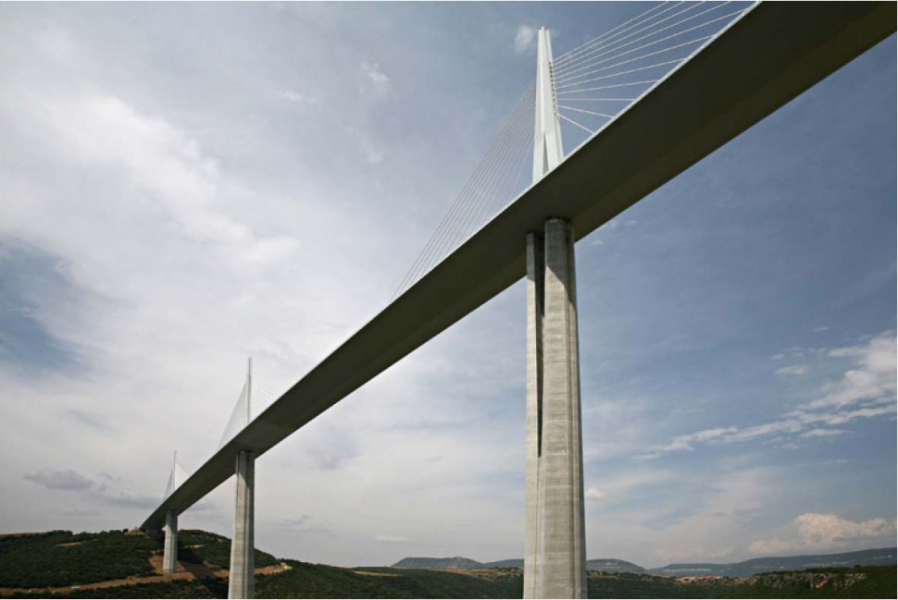

Infrastructure Investment Plan
Sets out:
  why we invest;
  how we invest; and
  what we invest in.
Scotland’s Economic Strategy
National Planning Framework

Slide 7
IIP Guiding Principles
Delivering sustainable economic growth;
managing the transition to a more resource efficient, lower carbon economy;
supporting delivery of efficient and high quality public services; and
supporting employment and opportunity across Scotland.

Slide 8
IIP Key Priorities
Transforming early learning and childcare – expansion to 1140 hours per year;
Enhancing housing supply in Scotland – 50,000 homes;
Creating a new, overarching energy strategy for Scotland, as well as recognising it as a national infrastructure priority;
Continue with expansion of broadband;
Investment in healthcare infrastructure
Investment to improve transport infrastructure

Slide 9
The Future
2015 IIP built on many key commitments from the 2011 plan
Next plan:
  Continued focus on economy
  Guiding principles being further developed – prioritisation methodology
  New manifesto plans

Slide 10
IIP Reporting
Progress Report for 2016
Project Pipeline update
Programme Pipeline update
Major Capital Projects Progress update

Slide 11
Major Capital Projects Database
Key information source for Ministers
Updated twice a year
Information needs to be accurate – used to provide briefing and advice to Ministers
Reporting and accountability requirements

Slide 12
Accountability
Scottish Ministers
Parliament
Public Audit and Post-legislation Committee
Finance and Constitution Committee
Infrastructure Investment Board

Slide 13
Any questions?

